Slide 1
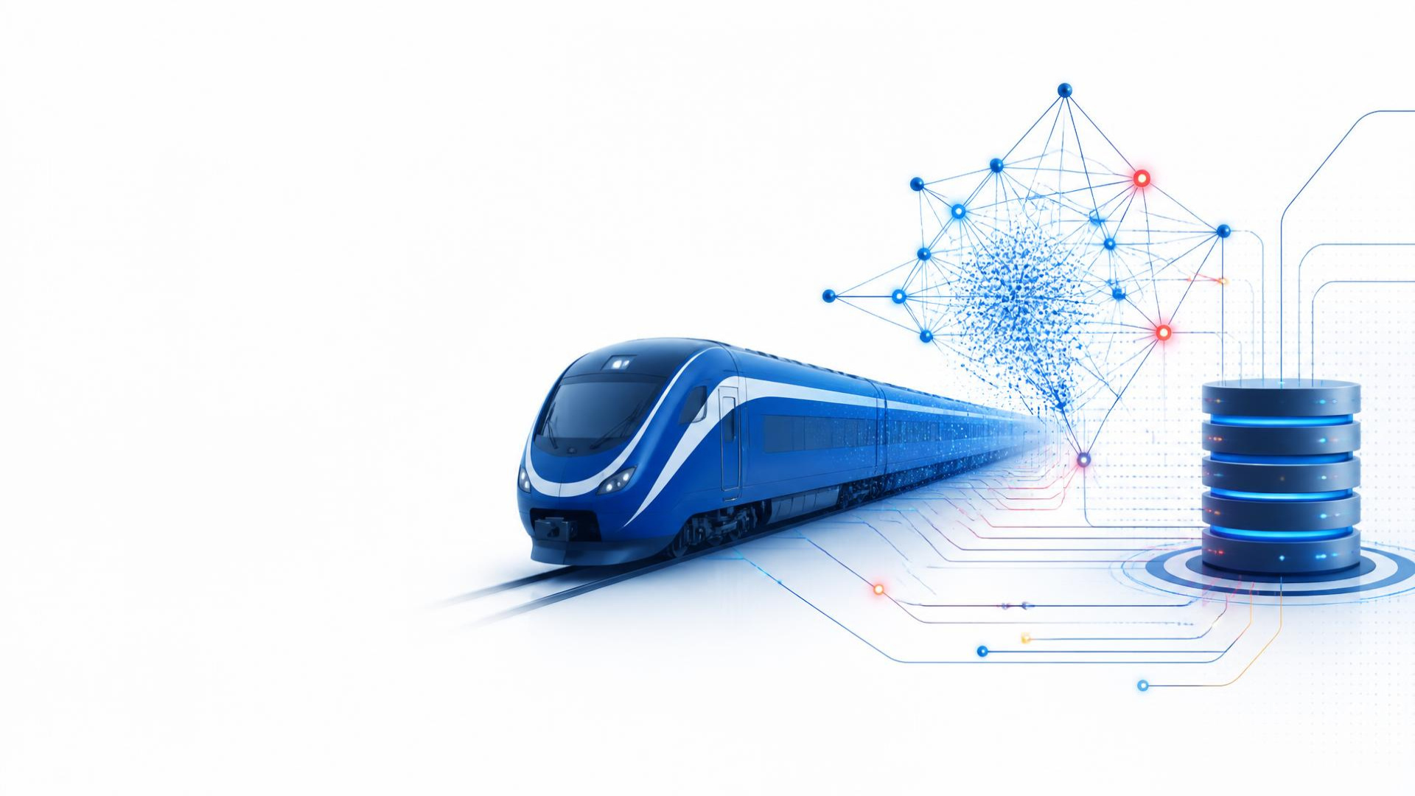
GenAI-Powered
Indian Railways
Administrator
Supervisor-Based Multi-Agent Architecture for Ticket & Transaction Information
NAME : Akanksha Sandeep Netkar
ROLL NUMBER : 99
COURSE : Gen AI

Slide 2
Problem Statement
02
Railway administrators need reliable ticket and transaction information from structured records—without manually searching rows or writing SQL.
INFORMATION RETRIEVAL PATH
USER
NATURAL-LANGUAGE
QUERY
STRUCTURED
DATABASE
VERIFIED
INFORMATION
01
02
03
04
05
Natural-language
queries
Structured database
records
Different query
types
Fast information
retrieval
Reduced manual
record searching

Slide 3
Project Abstract & Objectives
03
This prototype demonstrates a GenAI supervisor coordinating specialized agents to retrieve verified railway ticket and transaction information from SQLite sample data.
01
02
03
Natural Language Interface
GenAI Supervisor
Specialized Agents
Accept natural-language railway queries
Qwen2.5-3B-Instruct understands and routes
Ticket, Transaction, Passenger, Admin
04
05
06
Database Integration
Verified Retrieval
Interactive Dashboard
Connect agents to SQLite records
Return database-grounded information
Present results through Streamlit

Slide 4
Proposed GenAI Multi-Agent Architecture
04
USER
NATURAL LANGUAGE
QUERY
QWEN GenAI
SUPERVISOR
QUERY UNDERSTANDING
QUERY ROUTING
TICKET
AGENT
SQLITE
DATABASE
VERIFIED
RESULT
TRANSACTION
AGENT
PASSENGER
AGENT
DATABASE RETRIEVAL
VERIFIED RESULT
USER
ADMIN
AGENT
STREAMLIT ADMINISTRATOR DASHBOARD

Slide 5
Technical Stack
05
PROGRAMMING
GENAI / LLM
MODEL RUNTIME
AGENT ARCHITECTURE
Python
Qwen2.5-3B-Instruct
Transformers + PyTorch
LangGraph + LangChain
Core implementation
Understanding & supervisor routing
Inference on GPU
State workflow & conditional routing
DATABASE & DATA
FRONTEND
EXECUTION
SQLite + Pandas
Streamlit
Google Colab + Tesla T4
Structured storage & inspection
Administrator interface
Development & execution environment

Slide 6
Installation & Environment Setup
06
PACKAGE INSTALLATION
GOOGLE COLAB
TESLA T4 GPU
pip install transformers accelerate
pip install langgraph langchain langchain-community
pip install streamlit pandas
PYTHON ENVIRONMENT
PACKAGE INSTALLATION
Environment principle: verify compute first, then model, data, and application layers.
PYTORCH / CUDA CHECK
MODEL SETUP
DATABASE SETUP
APPLICATION

Slide 7
Railway Database Design
07
railway_database.db / tickets
Ticket_ID · Transaction_ID · Passenger_Name · Train · Source · Destination · Journey_Date · Class · Seat · Status · Fare
SAMPLE RECORDS (10)
TKT1001 TXN5001 Aarav Mehta Rajdhani Express Confirmed
TKT1002 TXN5002 Priya Sharma Duronto Express WL
TKT1003 TXN5003 Rohan Das Intercity Express Confirmed
TKT1004 TXN5004 Neha Singh Shatabdi Express Confirmed
TKT1005 TXN5005 Imran Khan Garib Rath Cancelled
TKT1006 TXN5006 Kavya Iyer Vande Bharat Confirmed
TKT1007 TXN5007 Aditya Rao Humsafar Express WL
TKT1008 TXN5008 Meera Nair Jan Shatabdi Confirmed
TKT1009 TXN5009 Arjun Patel Tejas Express Confirmed
TKT1010 TXN5010 Sana Ali Sampark Kranti Cancelled
TXN5004 → TKT1004
Neha Singh · Shatabdi Express
Delhi → Chandigarh · Confirmed
NATURAL LANGUAGE
AGENT
SQL QUERY
SQLITE RECORD
VERIFIED RESULT
The GenAI model does not store ticket data. Final information is retrieved from SQLite.

Slide 8
Implementation & Coding
08
1
DATABASE
SQLite connection · SQL queries · ticket retrieval
REPRESENTATIVE ROUTING
route = supervisor(query)
result = agents[route](query)
SELECT * FROM tickets
WHERE Transaction_ID = ?
2
AGENTS
Ticket · Transaction · Passenger · Admin
3
SUPERVISOR
Qwen2.5-3B-Instruct · intent & routing
The workflow separates reasoning, routing, retrieval, and presentation.
4
LANGGRAPH
StateGraph · conditional workflow
5
STREAMLIT
Query input · verified result display

Slide 9
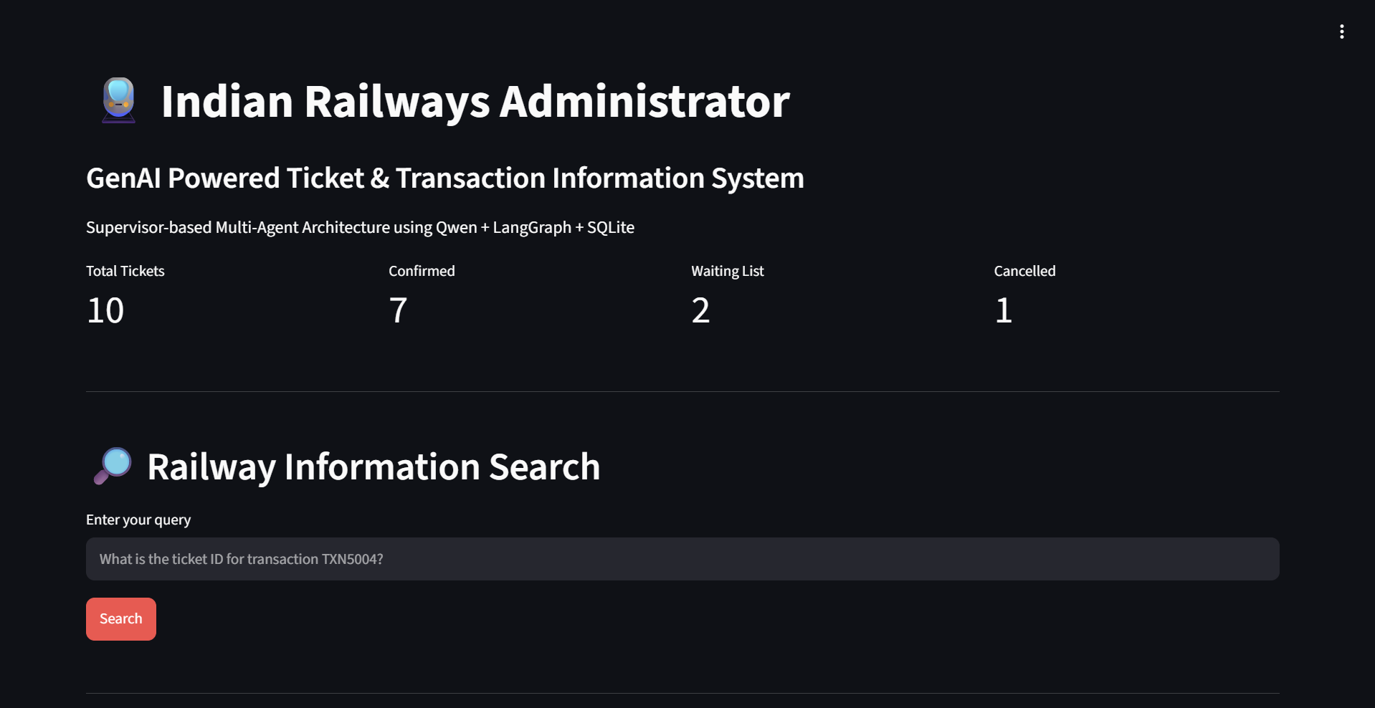
System Demonstration — Administrator Dashboard
9
Figure: Main Dashboard of the GenAI-Powered Indian Railways Administrator System

Slide 10
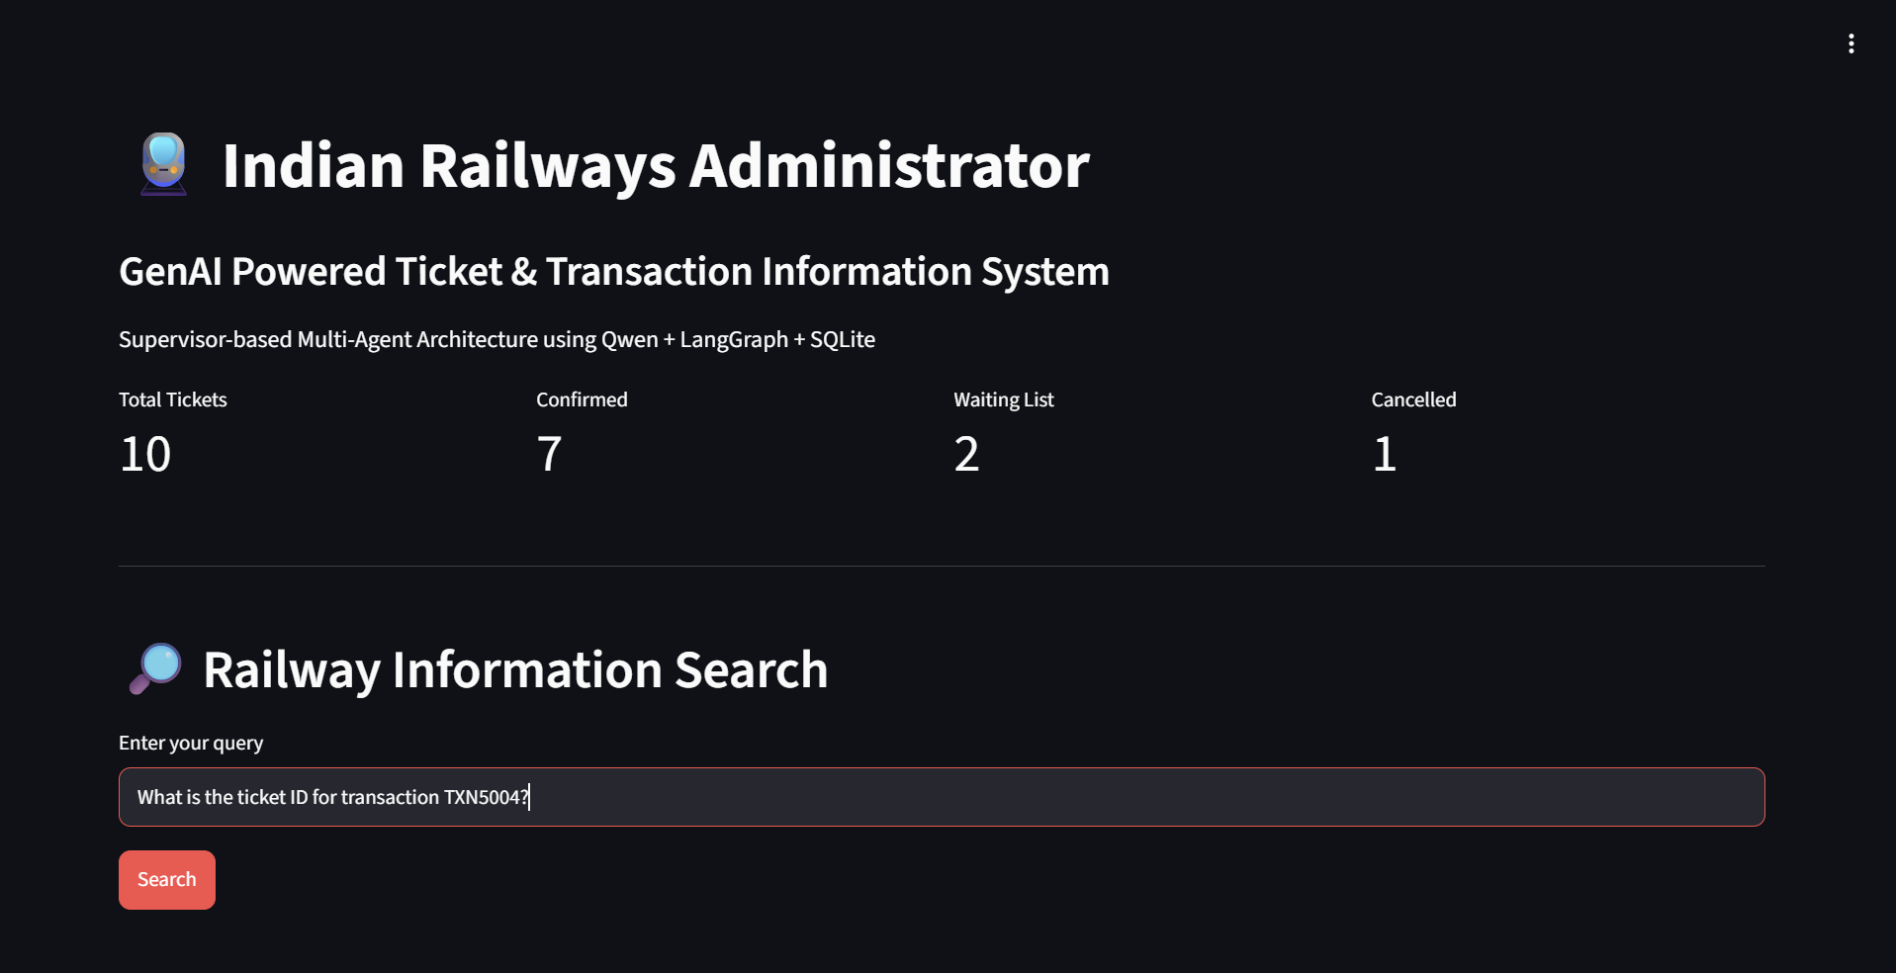
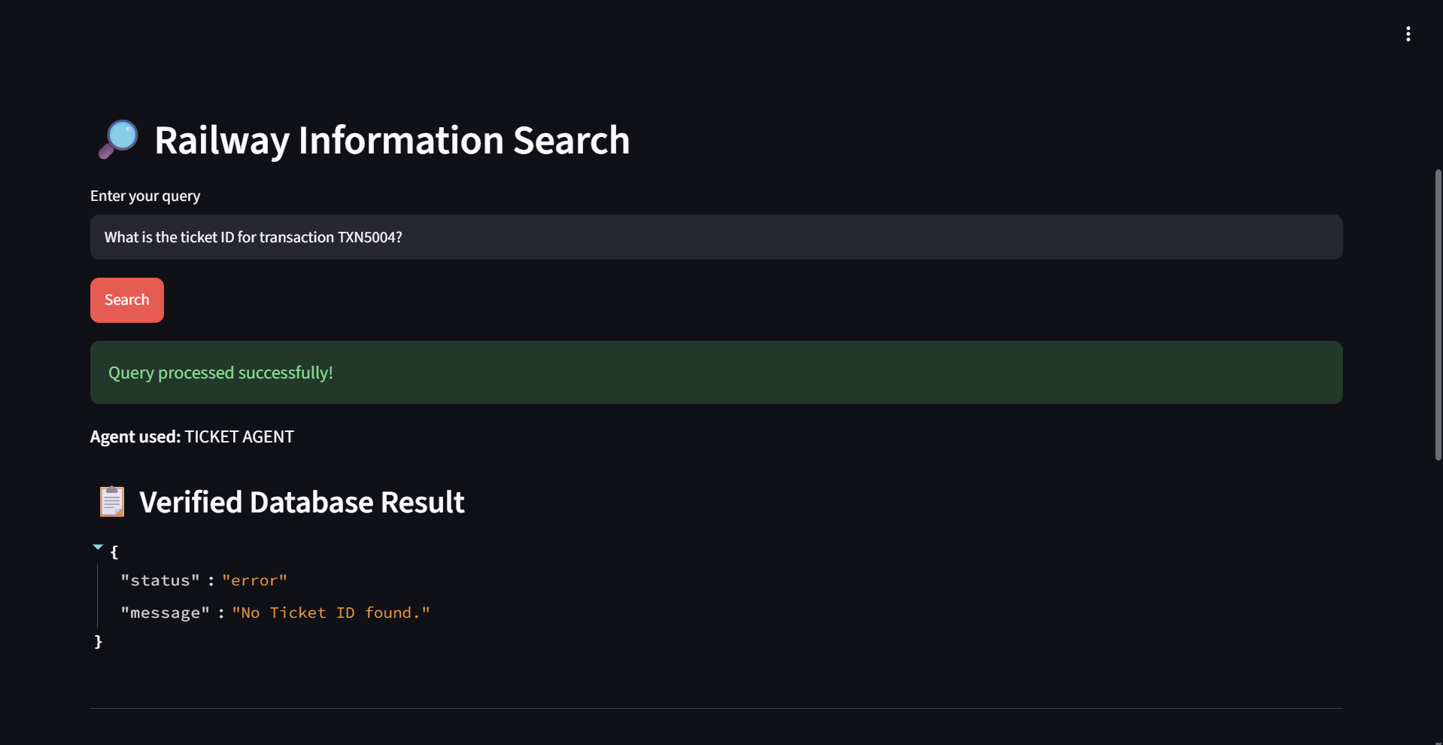
Query Execution & Final Output
10
TRANSACTION ID QUERY INPUT
TRANSACTION ID QUERY OUTPUT
SEARCH
The Transaction Agent retrieves the corresponding ticket information from SQLite and returns the verified record.
RELATED EVIDENCE: Ticket Details Query • Ticket Fare Query

Slide 11
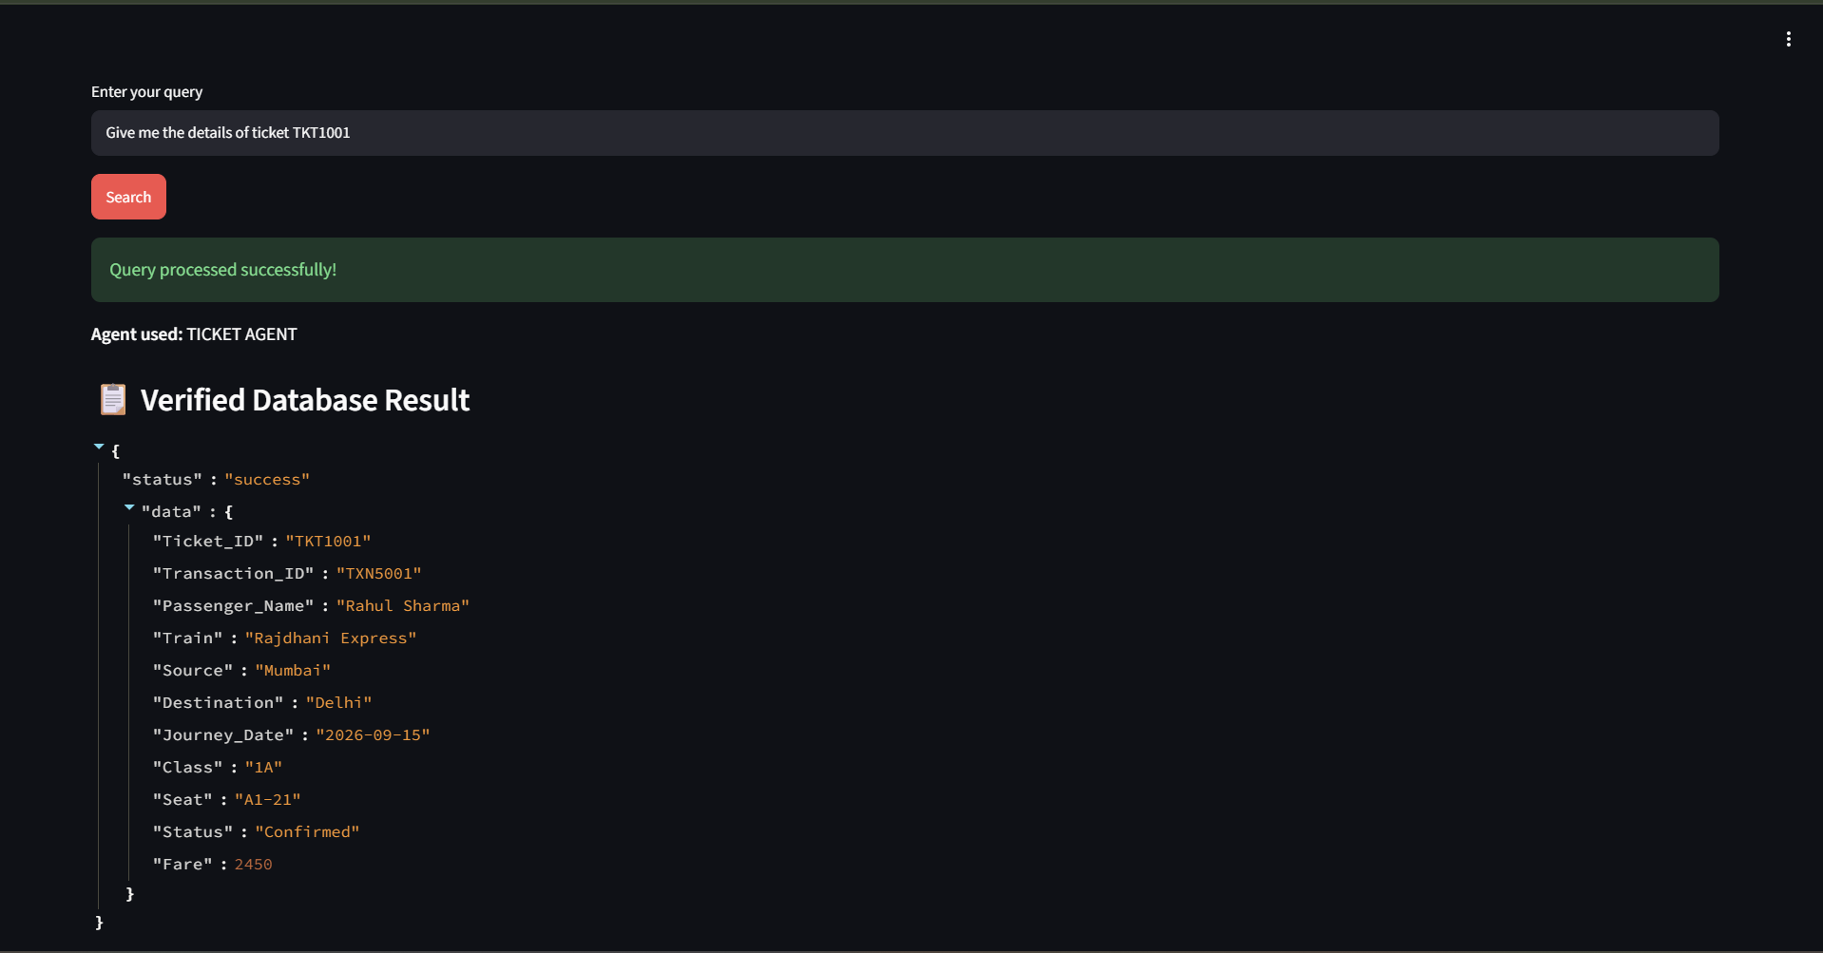
Ticket Details Query input and output
11

Slide 12
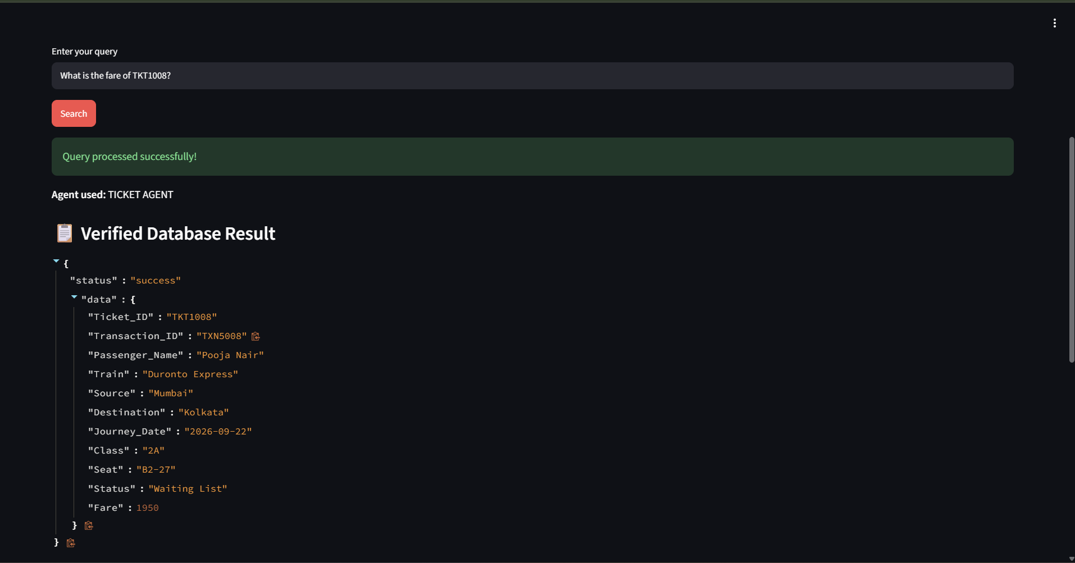
Ticket Fare Query input and output
12

Slide 13
Results, Conclusion & Future Scope
13
RESULTS
CONCLUSION
FUTURE SCOPE
• Supervisor-based architecture implemented
• Natural-language queries processed
• Routed to specialized agents
• Verified SQLite retrieval
• Streamlit dashboard implemented
Generative AI, multi-agent routing, and a structured railway database can work together to deliver grounded administrator information.
• Live railway database integration
• Authentication & role-based access
• Larger datasets and more agents
• Real-time monitoring & analytics
• Voice queries and secure deployment
THANK YOU

